Slide 1
Predicting Mortality of ICU Patients
Team: Horizon
Ding Jiayi m5262103
Ding Jiongjiong m5252104
Xue Bowen m5262118
Liang Ziwei m5262105

Slide 2
Outline
Introduction
Data pre-processing
Training model
Evaluate
Results

Slide 3
Introduction
The development of methods for prediction of mortality rates in Intensive Care Unit (ICU) populations has been motivated primarily by the need to compare the efficacy of medications, care guidelines, surgery, and other interventions when, as is common, it is necessary to control for differences in severity of illness or trauma, age, and other factors.

Slide 4
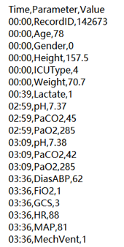
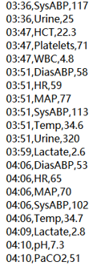
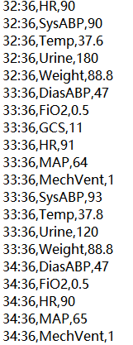
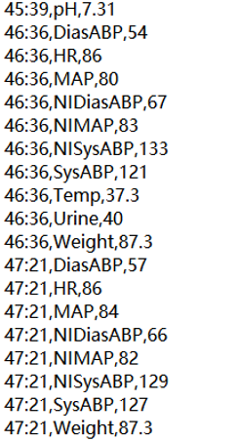
Data pre-processing
According to the given data files, patient data consists of static variables (height, weight, gender, etc.) and dynamic variables (changes in various index values).

Slide 5
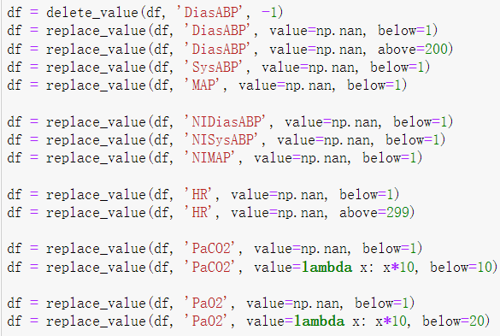
Data pre-processing
1.For the static variables，
Set unreasonable values to null values, unify units, and modify incorrect values.
2.For the dynamic variables：
First delete and replace some special variable values.
Then, the repetitive features are processed in a targeted manner.
Replace value
Notes:
For some features, keep the first value, last value, lowest value, highest value, and calculated mean.
For some features, only the initial and last values are kept.
For individual special features, custom reserved values.

Slide 6
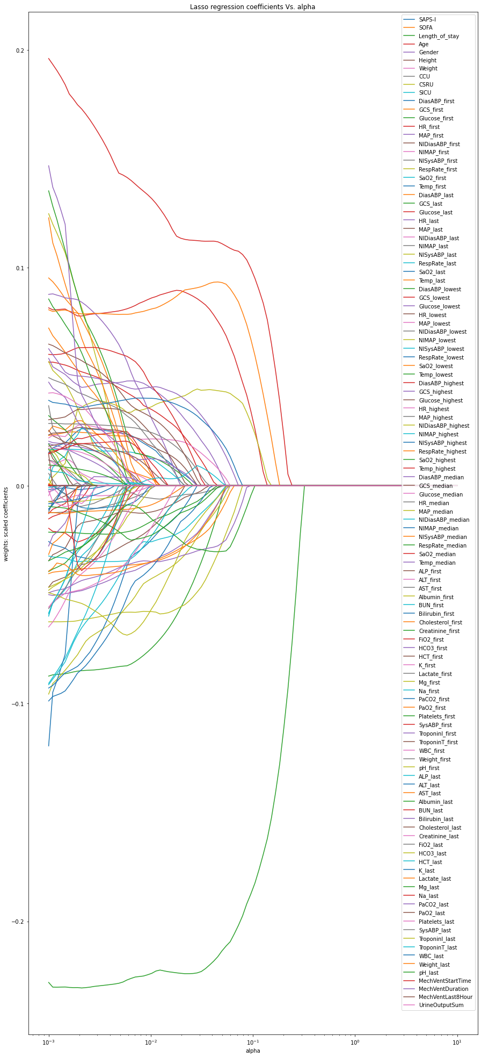
LASSO Feature Selection
Lasso method can compress the coefficients of features, and make some regression coefficients become 0, to achieve the purpose of feature selection.
Fig. 2 LASSO regression coeffcients Vs alpha
Notes:
First, we use lasso method which can compress the coefficients of features, and make some regression coefficients become 0, to achieve the purpose of feature selection.
Figure. 2 shows the variation of the coefficient of different variables after alpha penalty, and the variable whose coefficient is not 0 should be retained. Variables where the coefficient goes to zero as alpha increases are more important in the model.

Slide 7
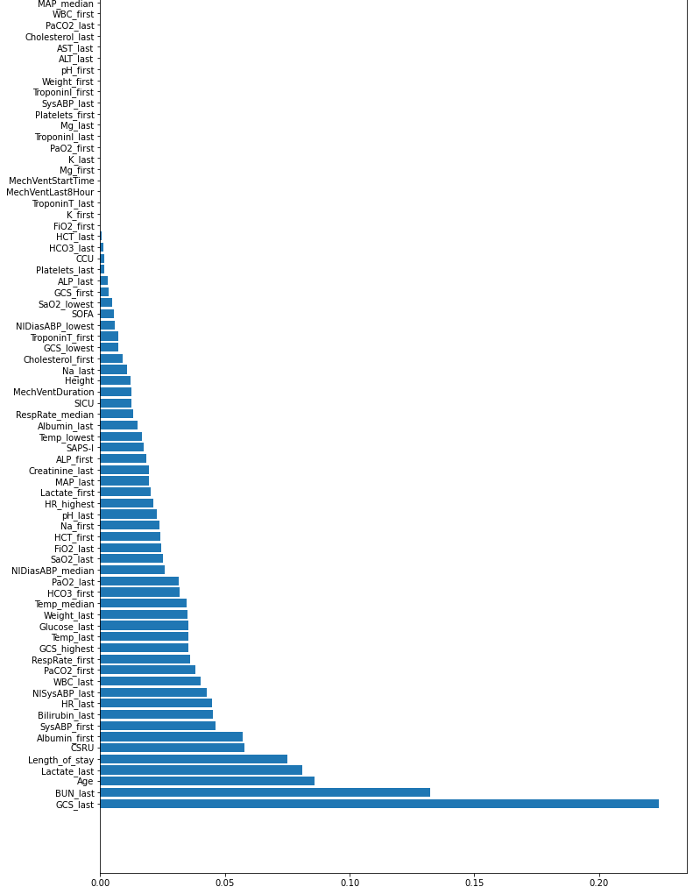
LASSO Feature Selection
Features with a coefficient of 0 are ignored and do not participate in the training of the model.
Fig. Features importance

Slide 8
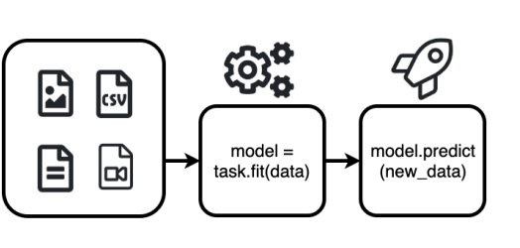
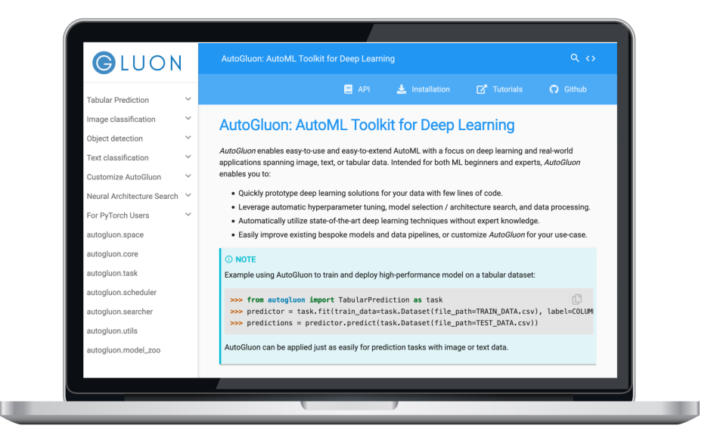
AutoGluon: AutoML Toolkit for Deep Learning
https://auto.gluon.ai
Quick prototyping achieving state-of-the-art performance for the following:
• Tabular prediction
• Image classification
• Object detection
• Text classification
• Customizing model searching
• Hyperparameter optimization on model training in Python or PyTorch
• Neural architecture searching

Slide 9
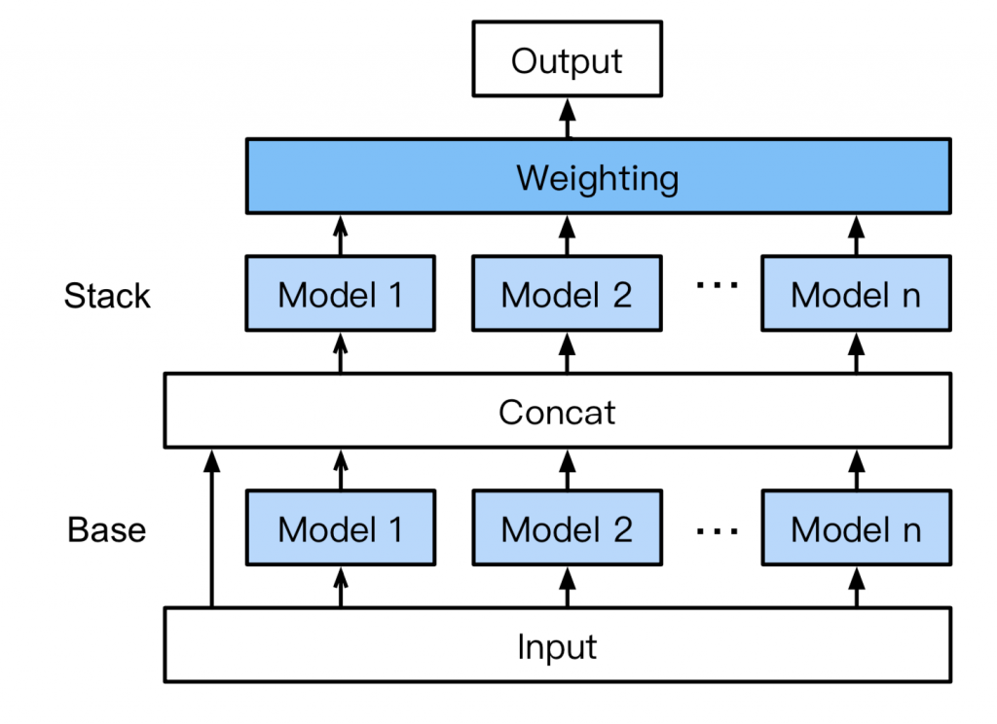
AutoGluon-Tabular:
Base layer: Individually trains multiple base models described in the model fitting section.
Concat layer: The output of the first layer is concatenated, along with the input features.
Stacker layer: Multiple stacker models are trained on the Concat layer output.
Weighting layer: An ensemble selection approach is implemented in which stacker models are introduced into a new ensemble such that the validation accuracy is maximized.
3-fold
data
K-Fold Bagging:
To ensure that the entire dataset is seen by every learner, AutoGluon-Tabular performs k-fold cross-validation.
Fold-1
train
train
val
Average
Fold-2
train
val
train
Fold-3
val
train
train

Slide 10



Evaluation1
Clinical Data-A
4000 participants
Dataset-B
4000 participants
Training
(n=3200)
Testing
(n=800)
567 In-hospital-death
3433 Not-death
Model fitting
Evaluation1
Trained Model
Evaluation2

Slide 11
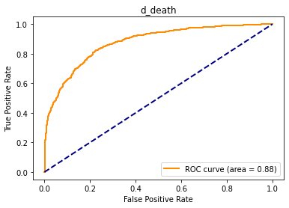
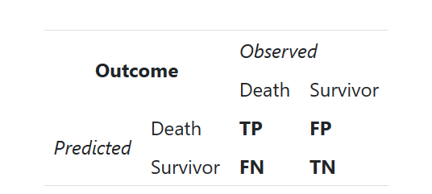
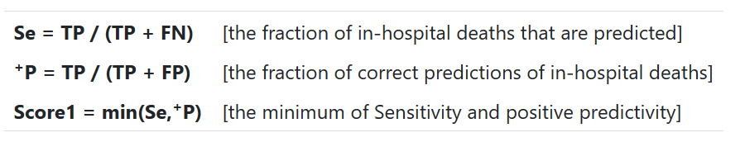

Evaluation 2
Scoring for Event 1 is based on 2 metrics: Sensitivity (Se) and positive predictivity(⁺P). We define the numbers of true positives (TP), false positives (FP), false negatives (FN), and true negatives (TN) as below:

Slide 12
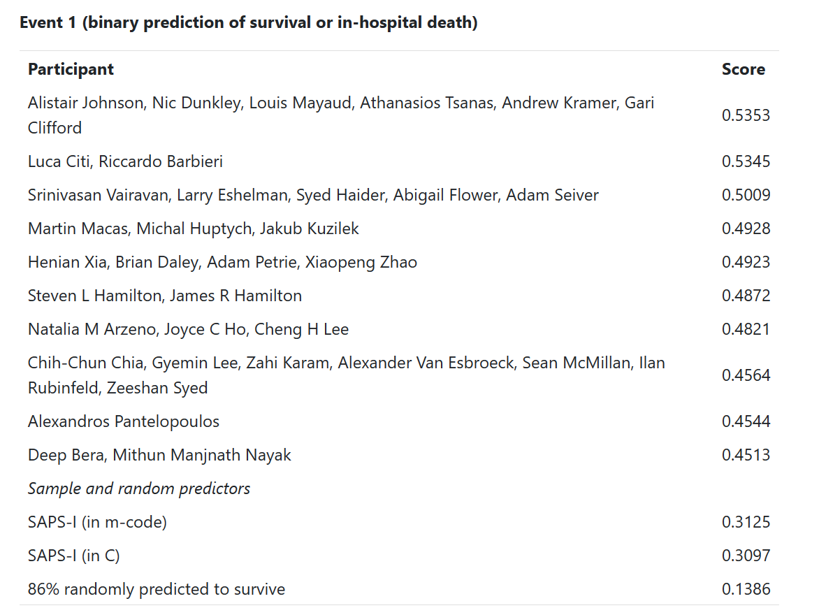
Results
The top 10 (of 28) participants in event 1 are listed above. The range is 0 (worst) to 1 (ideal).
Score: 0.7059

Slide 13
ML algorithms for tabular prediction
• Random Forest
• https://scikitlearn.org/stable/modules/generated/sklearn.ensemble.RandomForestClassifier.html
• XT (extremely randomized trees)
• https://scikitlearn.org/stable/modules/generated/sklearn.ensemble.ExtraTreesClassifier.html
• K-nearest neighbors
•https://scikitlearn.org/stable/modules/generated/sklearn.neighbors.KNeighborsClassifier.html
• CatBoost: Gradient boosting on decision trees
• https://catboost.ai/
• LightGBM
• https://lightgbm.readthedocs.io
• Neural network

Slide 14
Thank You For Listening!

